Slide 1
Deliverable 4
By: Dewey Decimal 7

Slide 2
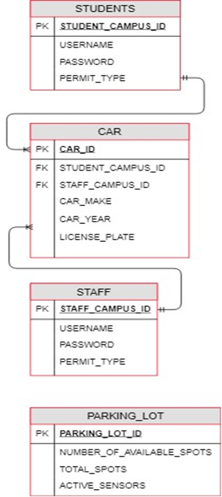
Entity Relationship Diagram
Students Table:
-Holds username,password,and permit type
-Students can have many cars
Staff Table:
-Same as student table
-Used for staff information instead
Car Table:
-Holds the car information, and student/faculty IDs as foreign keys
-Cars can only belong to one student/staff member
Parking_Lot Table:
-Keeps track of available spots in a specific lot
-Keeps track of active sensors
Notes:
jake

Slide 3
HW/SW Specifications
Standard Client:
Android Phones
Apple Phones
Standard Application Server:
SW: Java/Linux
HW: UMBC’s equipment
Standard Database Server:
SW:SQL/Oracle
HW: UMBC’s database for parking

Slide 4
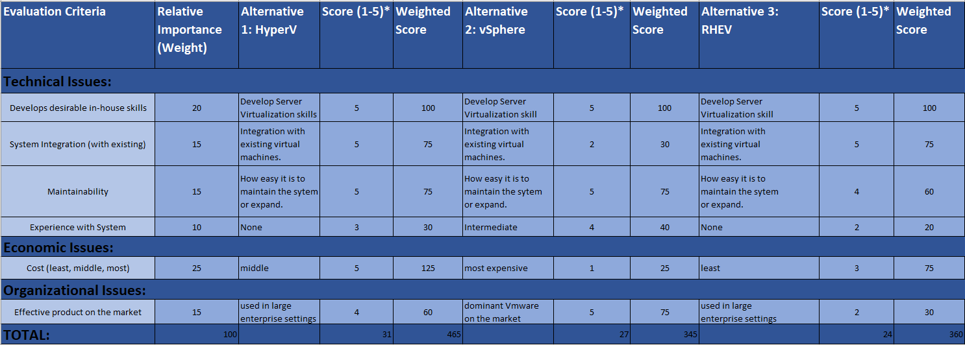
Alternative Matrix - Team Member 1

Slide 5
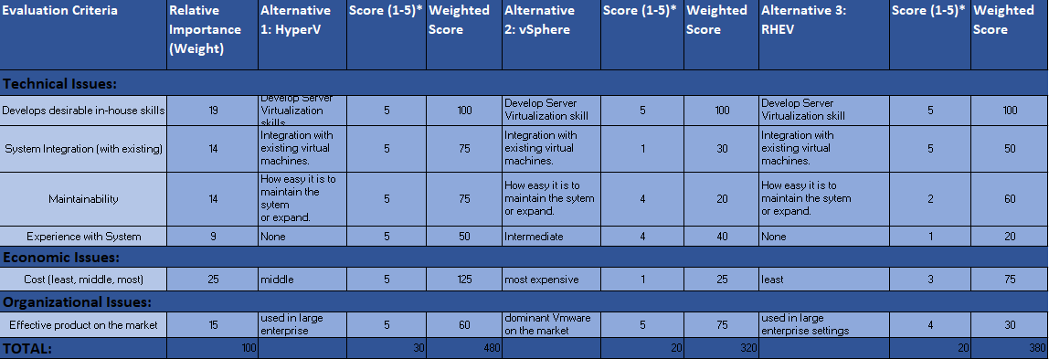
Alternative Matrix - Team Member 2

Slide 6
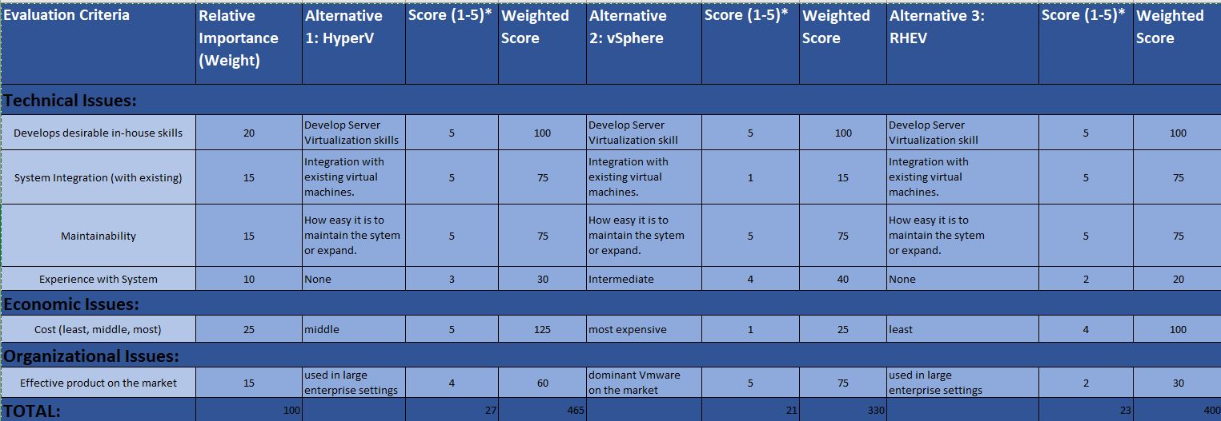
Alternative Matrix - Team Member 3

Slide 7
Alternative Matrix - Team Consensus
As a team we chose to implement HyperV for the following reasons:
-Cost
-Learning curve
-Desirable work skills for UMBC employees
-Well known product

Slide 8
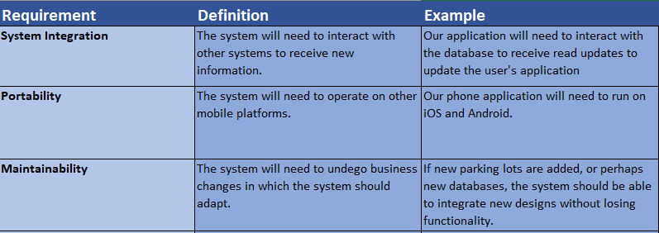
Operational Requirements

Slide 9
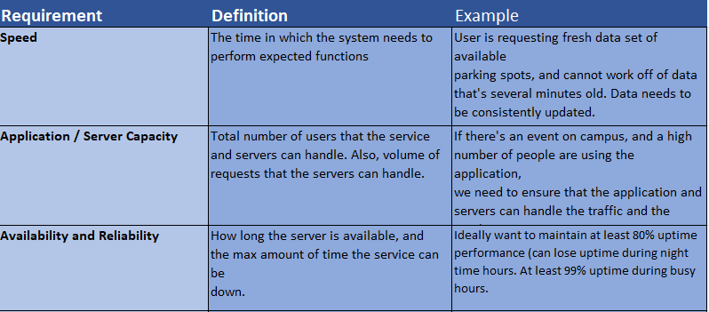
Performance Requirements

Slide 10
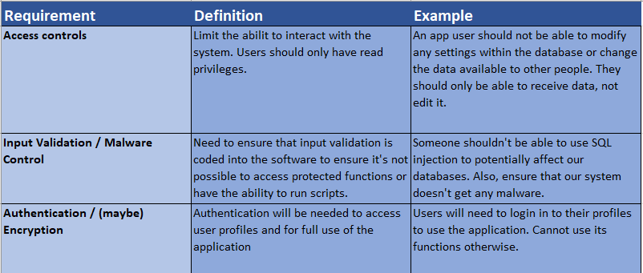
Security Requirements

Slide 11
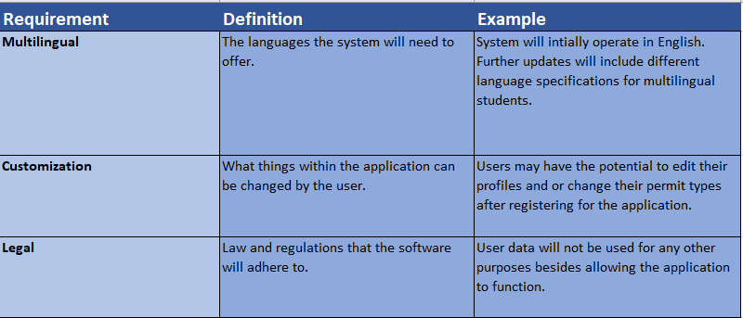
Cultural / Political Requirements

Slide 12
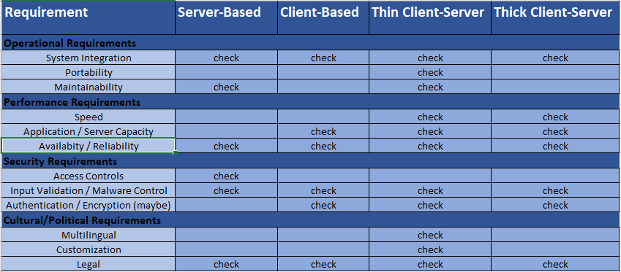
Decision Matrix

Slide 13
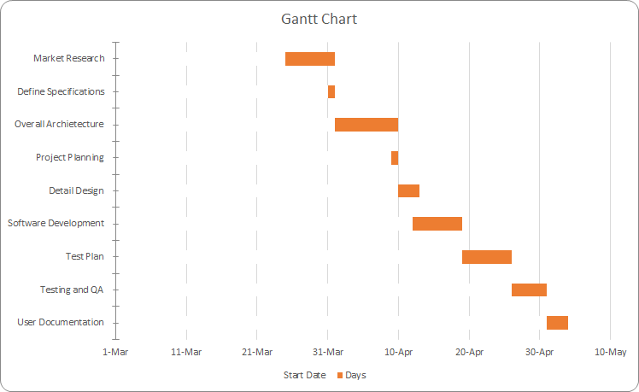
GANTT CHART

Slide 14
Updated Project Plan
Original
Planning (10%) 2 months
Analysis (20%) 4 months
Design (30%) 6 months
Implementation (40%) 8 months
Approx. Total Project Length 20 months
Updated
Planning (10%) 1 month
Analysis (20%) 4 months
Design (30%) 7 months
Implementation (40%) 8 months
Approx. Total Project Length 20 months

Slide 15
Project Plan Cont
As our project moves into the implementation phase, we will be focusing on commons garage to implement the first set of lasers for the parking system.
It will take a good portion of the summer but we hope to have the first set of sensors in by the fall semester. So we can get feedback from the students.
Once we get the feedback we will begin working on improvements.
Once we implement the improvements we will start working on installing sensors in all of the other lots toward the end of the fall semester.

Slide 16
Deliverable 5
By: Dewey Decimal 7

Slide 17
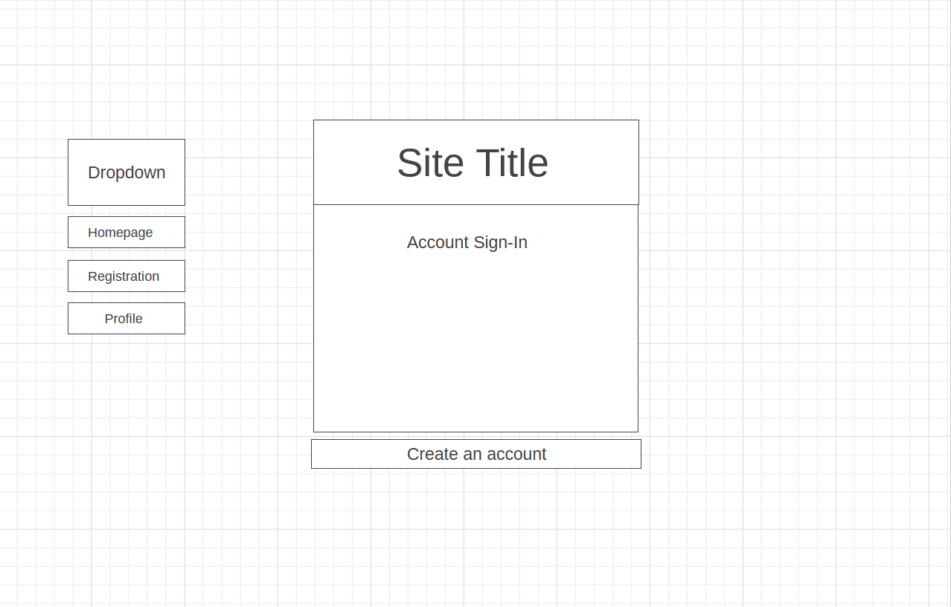

Slide 18
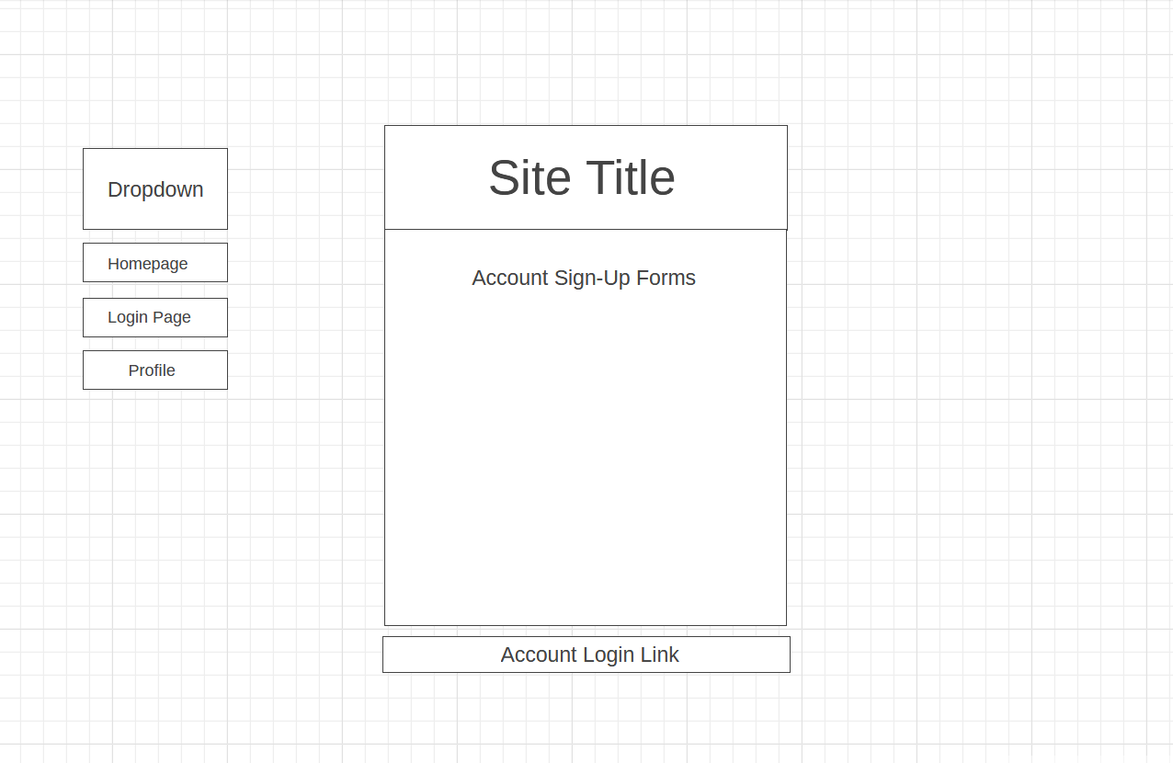

Slide 19
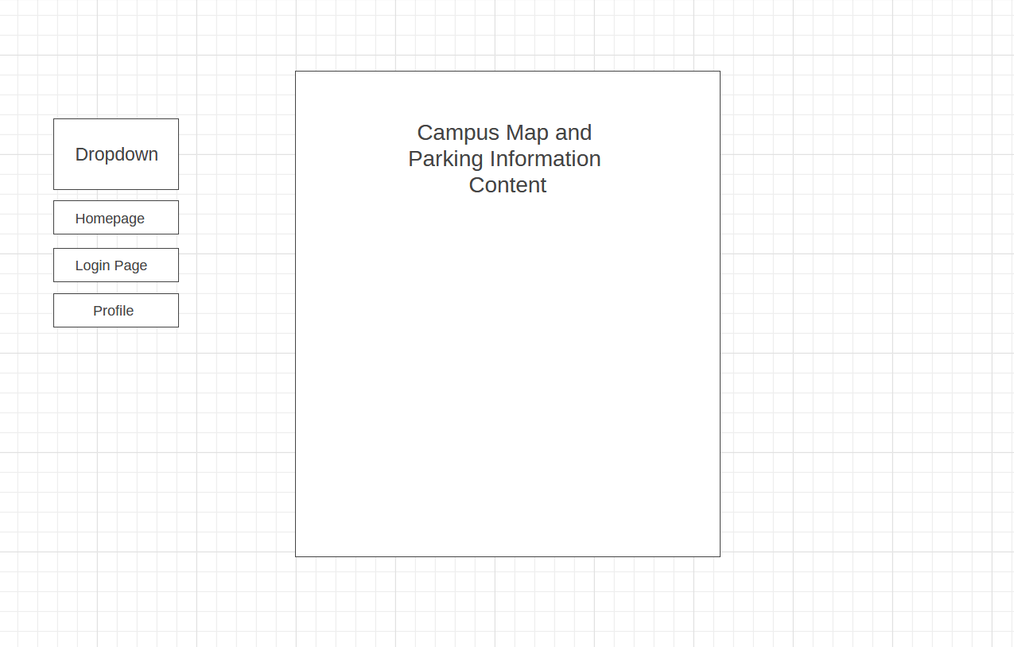

Slide 20
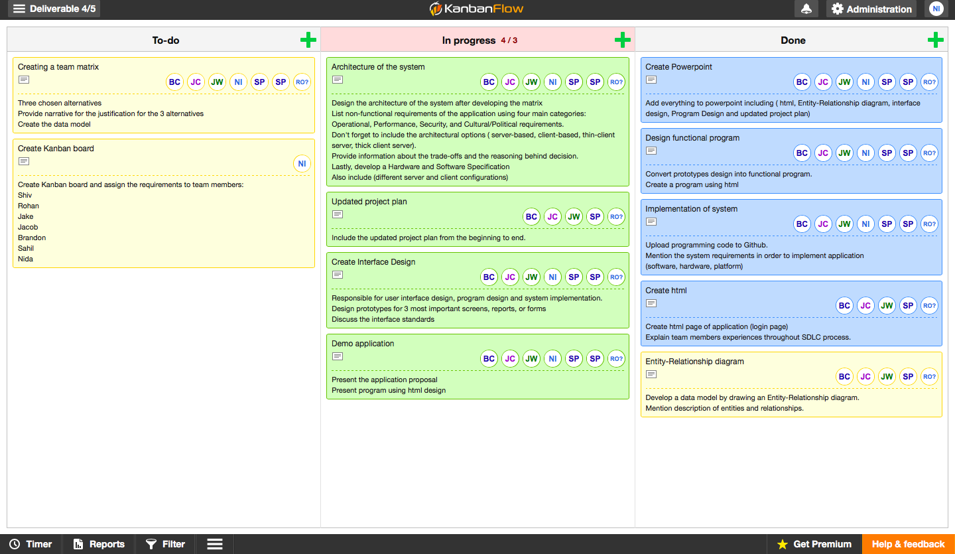

Slide 21
GitHub Link
https://htmlpreview.github.io/?https://raw.githubusercontent.com/jakecooper11/deliverable-5/master/AppStartPage.html

